Slide 1
FHWA
Steve Mills
Assistant Division Administrator

Slide 2
Topics
FHWA staff assignments
FHWA Process reviews
EDC-4 initiatives being considered
Status of Transportation Performance Management / Measures

Slide 3
FHWA
Design Assignments
David Whitworth – (502) 223-6741
Project Delivery Team Leader & ROW Officer
Duane Thomas – (502) 223-6749
Districts 1 and 2
Ryan Tenges – (502) 223-6750
Districts 3, 7, 8, and 9
Dana Robbins – (502) 223-6757
Districts 4, 10, and 12
Michael Loyselle – (502) 223-6748
Districts 5, 6, and 11

Slide 4
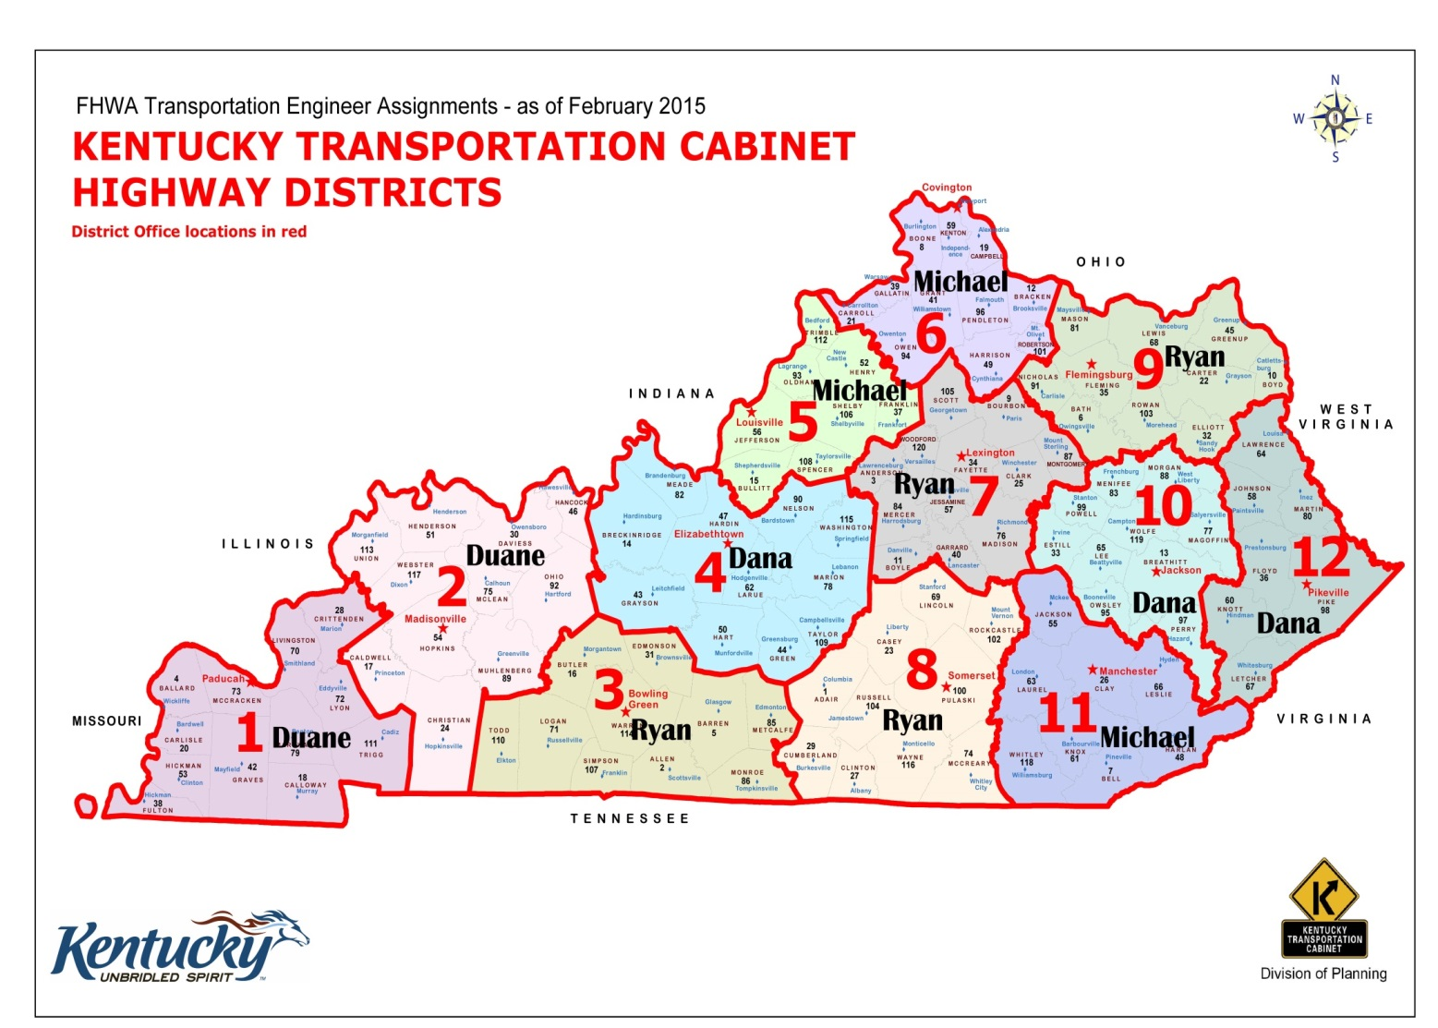
FHWA
Division Assignments

Slide 5
FHWA
Planning & Environment Assignments
John Ballantyne – (502) 223-6747
Program Delivery Team Leader
Bernadette Dupont – (502) 223-6729
MPOs: Cincinnati, Elizabethtown,
Henderson, Owensboro, Lexington
Greg Rawlings – (502) 223-6728
MPOs: Louisville, Bowling Green, Ashland,
Clarksville
Eric Rothermel
Environmental: Statewide

Slide 6
Topics
FHWA staff assignments
FHWA Process reviews
EDC-4 initiatives being considered
Status of Transportation Performance Management / Measures

Slide 7
FHWA Process Reviews
FHWA Process Reviews for 2016/2017
Project Closeout
DBE Commercially Useful Function (CUF)
LPA Construction Authorization Process
KYTC encroachment Permit Process
HSIP
Pavement Life

Slide 8
Topics
FHWA staff assignments
FHWA Process reviews
EDC-4 initiatives being considered
Status of Transportation Performance Management / Measures

Slide 9
EDC-4 Initiatives Being Considered
KYTC considering new round of EDC-4 initiatives
Automated Traffic Signal Performance Measures (ATSPMs)
Collaborative Hydraulics
Community Connections
Data-Driven Safety Analysis (DDSA)
e-Construction and Partnering
Integrating NEPA and Permitting
Pavement Preservation
Road Weather Management
Safe Transportation for Every Pedestrian (STEP)
Ultra-High Performance Concrete Connections
Using Data to Improve Traffic Incident Management

Slide 10
Topics
FHWA staff assignments
EDC-4 initiatives being considered
Status of Transportation Performance Management / Measures

Slide 11
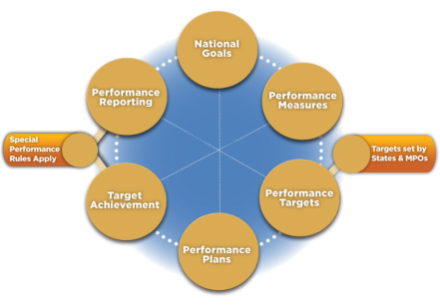
Transportation Performance Measures

Slide 12
FHWA PM Rulemaking Schedule
Performance Area | NPRM | Comments Due | Final Rule
Safety Performance Measures | March 11, 2014 | Closed June 30, 2014 | Published March 15, 2016
Highway Safety Improvement Program | March 28, 2014 | Closed June 30, 2014 | Published March 15, 2016
Statewide and Metro Planning; Non-Metro Planning | June 2, 2014 | Closed October 2, 2014 | Published May 27, 2016
Pavement and Bridge Performance Measures | January 5, 2015 | Closed May 8, 2015 | Anticipated November 2016
Highway Asset Management Plan | February 20, 2015 | Closed May 29, 2015 | Anticipated November 2016
Performance of the NHS, Freight, and CMAQ Measures | April 22, 2016 | Closed August 2016 | TBD

Slide 13
QUESTIONS?
Steve Mills
US Department of Transportation
Federal Highway Administration – KY
330 West Broadway
Frankfort, KY 40601-1981
Steve.Mills@dot.gov
(502) 223-6723

